Slide 1
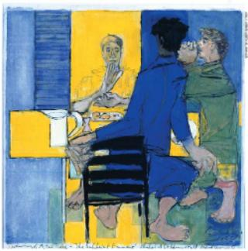
Teaching and Learning the Bible With Adults: (Lutheran) Theological Reading
Diane Jacobson -- Tuesday, March 30, 2010
An Interactive
Bible Study
Of
Luke 24:13-35

Slide 2
Notes:
2
Jacobson focuses on four ways to approach the Bible in study. These approaches are not the only ways to study the Bible, but they encompass key categories of study that, when used together, help us experience the Bible in a multi-dimensional way. Three of the four approaches we share with other Christians, while the fourth approach (Lutheran Theological Reading) is the unique and helpful “spin” we bring to reading and interpreting Scripture.
These four approaches are used in each of the four Bible studies in the final section of the book, and they will be used as an integrated approach to Bible study in other Book of Faith Bible studies yet to come.

Slide 3
Literary Reading
Theme and Purpose
Literary Context
Structure; form; type; movement; catch words and phrases
Character Analysis
Setting: Spatial, Temporal, & Social
Narrator’s point of view; rhetoric
Themes
Where is God?

Slide 4
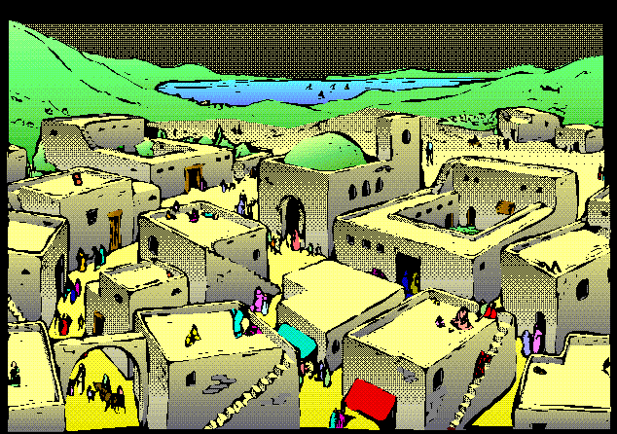
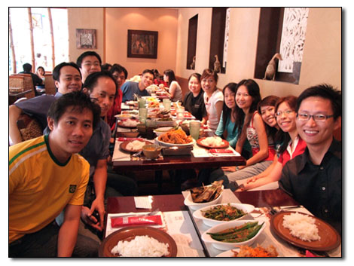
Literary Exercise #2
Notice Places
Choose a place to discuss:
Village, Jerusalem, Journey, Meal
Talk about this place in your life.
Where is your place found elsewhere in the Bible, and why it is important?

Slide 5
ELW 618 Guide Me Ever
Guide me ever, great Redeemer,
pilgrim through this barren land.
I am weak, but you are mighty;
hold me with your pow’rful hand.
Bread of heaven, bread of heaven,
feed me now and evermore, feed me now
and evermore.

Slide 6
Literary Reading
First Steps on Type and Theme
Literary Context
Setting: Spatial, Temporal, & Social
Exercise: Circle places/ times
Character Analysis/ Point of View
Literary Exercise #3: Take on a character
Important Themes

Slide 7
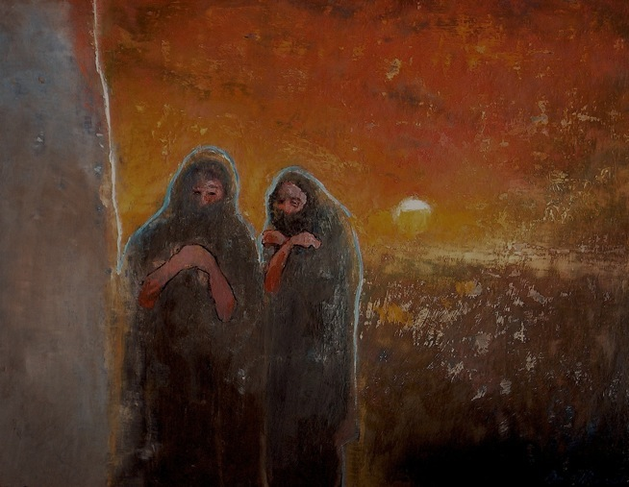
Literary Exercise #4
Underline verbs in verses 28-29

Slide 8
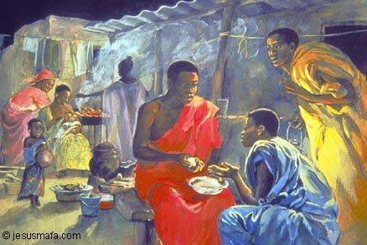
Literary Exercise #4
Underline verbs in verses 30-32

Slide 9
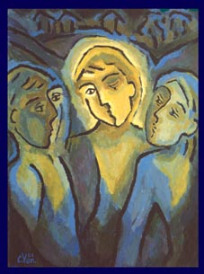
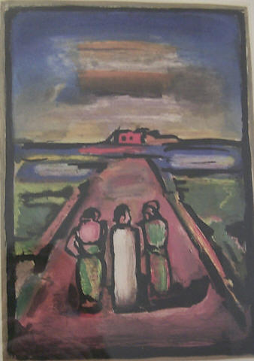
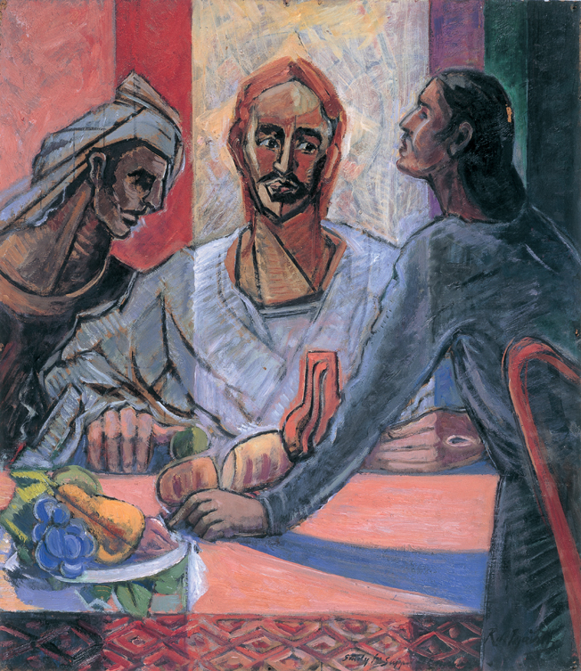
Literary Exercise #4
Underline verbs in verses 33-35

Slide 10
Lutheran Insights about the Bible
Notes:
10

Slide 11
We Read Scripture
prayerfully, humbly, mindfully, expectantly
“The Holy Scriptures require a humble reader
who shows reverence and fear toward the Word of God,
and constantly says,
‘Teach me, teach me, teach me….
The Spirit resists the proud.”
(Luther’s Works, vol.54, 379; Table Talk, 5017)

Slide 12
From the ELCA Constitution
A Three Fold Understanding of the Word
2.02. This church confesses Jesus Christ as Lord and Savior and the Gospel as the power of God for the salvation of all who believe.
a. Jesus Christ is the Word of God incarnate, through whom everything was made and through whose life, death, and resurrection God fashions a new creation.
b. The proclamation of God’s message to us as both Law and Gospel is the Word of God, revealing judgment and mercy through word and deed, beginning with the Word in creation, continuing in the history of Israel, and centering in all its fullness in the person and work of Jesus Christ.
c. The canonical Scriptures of the Old and New Testaments are the written Word of God. Inspired by God’s Spirit speaking through their authors, they record and announce God’s revelation centering in Jesus Christ. Through them God’s Spirit speaks to us to create and sustain Christian faith and fellowship for service in the world.

Slide 13
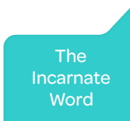
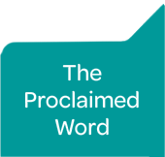
The Proclaimed Word is the Spoken Word of God

Slide 14
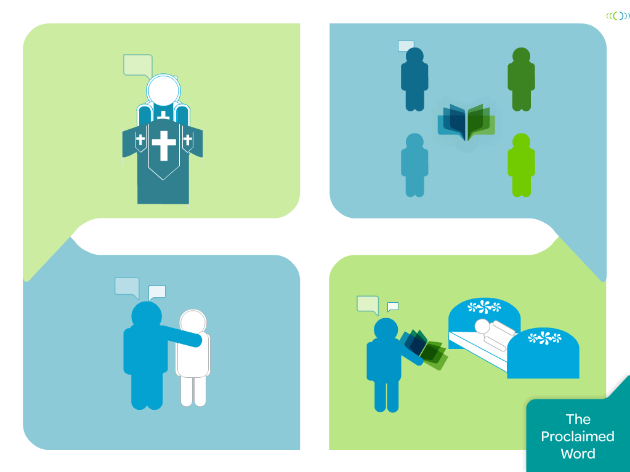
Notes:
2.02b.
The proclamation of God’s message to us as both Law and Gospel is the Word of God, revealing judgment and mercy through word and deed, beginning with the Word in creation, continuing in the history of Israel, and centering in all its fullness in the person and work of Jesus Christ. Lutherans also speak of the proclaimed or spoken Word (note the capital “W”). This is the proclaimed message that convicts people of their sin and offers the hope of salvation. “Lutherans call this ‘the message of law and gospel” (Powell). This message can be proclaimed in preaching, but it also can be spoken in conversation, shared in study, and expressed when we counsel and console one another.

Slide 15
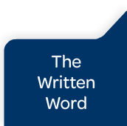
The Proclaimed Word is the Spoken Word of God

Slide 16
Lutheran Theological Reading
In what ways do we hear this passage as law?
In what ways do we hear
this passage as Gospel?
How does this passage show forth Christ?
What other passages from the Bible help us
to understand this passage?
How do others hear this text, especially folks
from cultures different from my own?

Slide 17
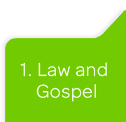
Notes:
Lutherans say that the Word of God speaks both law and gospel and that both must be held together for God’s Word to be fulfilled.
Lutherans talk a lot about law and gospel, and in a basic sense we are simply saying that the Bible speaks God’s word to us, and that this is always a word of judgment and salvation. It is a word that condemns us and redeems us. We are poor, human sinners, so God’s word always condemns us, but our God is a God of love and mercy, so God’s word always redeems us. Another way of saying this is, God’s Word reveals our brokenness (that is the law) and it also forgives and heals our brokenness (that is the gospel). [Powell, p. 29]

Slide 18
Genesis 2:8-9; 15-17
Genesis 2:8-17 ⁸ And the LORD God planted a garden in Eden, in the east; and there he put the man whom he had formed. ⁹ Out of the ground the LORD God made to grow every tree that is pleasant to the sight and good for food, the tree of life also in the midst of the garden, and the tree of the knowledge of good and evil. ….
¹⁵ The LORD God took the man and put him in the garden of Eden to till it and keep it. ¹⁶ And the LORD God commanded the man, "You may freely eat of every tree of the garden; ¹⁷ but of the tree of the knowledge of good and evil you shall not eat, for in the day that you eat of it you shall die."

Slide 19
Lutheran Theological Reading
In what ways do we hear this passage as law?
In what ways do we hear
this passage as Gospel?
How does this passage show forth Christ?
What other passages from the Bible help us
to understand this passage?
How do others hear this text, especially folks
from cultures different from my own?

Slide 20
Lutheran Theological Reading
In what ways do we hear this passage as law?
In what ways do we hear
this passage as Gospel?
How does this passage show forth Christ?
What other passages from the Bible help us
to understand this passage?
How do others hear this text, especially folks
from cultures different from my own?

Slide 21
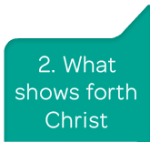
Notes:
When we Lutherans say the Bible is the Word of God we mean, above all, that the Bible is the book that reveals Jesus Christ to us. And by that we mean the whole Bible - not just the Gospels or the New Testament.
The Jesus we know and love is the Messiah of Israel, so the Scriptures of Israel - the Old Testament - also reveal him to us. . . . Everything in the Bible points us toward Christ and helps us to know Christ and to love Christ and to have a relationship with Christ, who is risen from the dead.
Martin Luther used to say the Bible is like the manger that held the Christ child. In many Christmas scenes, we see people kneeling before the manger to worship, but they are not worshiping the manger. They are worshiping the Christ child who is in the manger. So, also, we do not worship the Bible. We worship the Christ who is found in the Bible.
Mark Powell puts it this way: “Lutherans are Jesus people, and they understand the Bible to be a Jesus book.” [Powell, pp. 31-32]

Slide 22
Lutheran Theological Reading
In what ways do we hear this passage as law?
In what ways do we hear
this passage as Gospel?
How does this passage show forth Christ?
What other passages from the Bible help us
to understand this passage?
How do others hear this text, especially folks
from cultures different from my own?

Slide 23
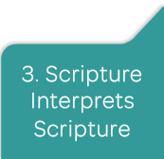
Notes:
Lutherans believe that difficult passages of Scripture are to be interpreted in light of those passages that are more readily understandable, and that all of Scripture is to be interpreted in light of the Bible’s central themes and motifs.
We often try to reconcile what is said in one part of Scripture with what is said in other parts of Scripture, sometimes recognizing that there is tension between texts that seem to say different things. We try to be faithful to the entire Bible rather than just picking some parts and leaving others alone.
In practice, interpreting Scripture in light of Scripture means that Lutherans must do some initial work at defining the teaching of “Scripture as a whole” so that they will be able to interpret individual passages in light of the broader themes and overall message. When we do this, people who are not Lutheran often think that we are interpreting the Bible in light of our own theology. We understand why they think that, but we think that we are interpreting scripture (individual passages) in light of Scripture (the Bible as a whole). [Powell, pp. 33-35]

Slide 24
Lutheran Theological Reading
In what ways do we hear this passage as law?
In what ways do we hear
this passage as Gospel?
How does this passage show forth Christ?
What other passages from the Bible help us
to understand this passage?
How do others hear this text, especially folks
from cultures different from my own?

Slide 25
Lutheran Theological Reading
In what ways do we hear this passage as law?
In what ways do we hear
this passage as Gospel?
How does this passage show forth Christ?
What other passages from the Bible help us
to understand this passage?
How do others hear this text, especially folks
from cultures different from my own?

Slide 26
Plain Meaning of the Text
“The Christian reader should make it his first task to seek out the literal sense, as they call it. For it alone holds its ground in trouble and trial.”
Martin Luther, Luther’s Works, vol.9, 24
We Read in Community

Slide 27
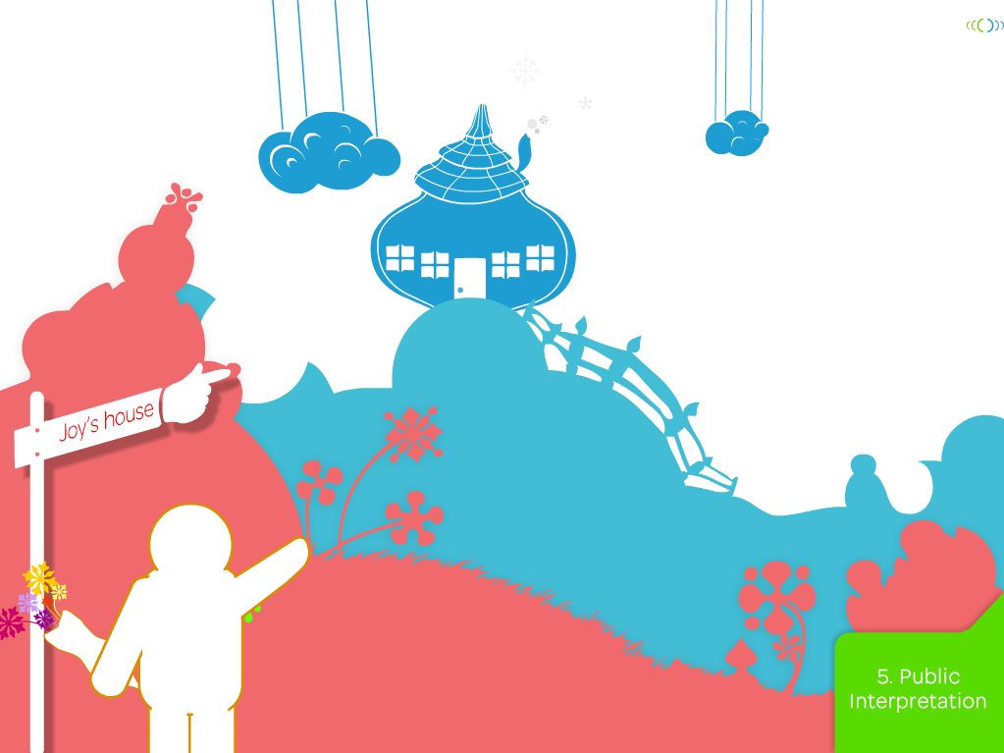
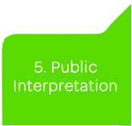
Notes:
27
Lutherans say that the interpretation of Scripture is a public act rather than a private one. Through the Bible, God speaks to Israel and to the church. God does not speak directly or privately to individuals. What God says to Israel and to the church may have specific application for individual lives, but the meaning of Scripture for individuals is to be in harmony with its universal meaning for the community of faith.
This principle is often difficult for some people to grasp. We do encourage personal and private Bible reading, and we do believe that the Bible speaks to people as a living Word with relevance to their individual lives. But Lutherans do not believe that this just happens automatically in a magical sort of way. People do not just open their Bibles to find private messages from God, words that would apply to them in a way that they would probably never apply to anyone else. [Powell, pp. 41-42] The humorous example in this slide is about the guy who read Isaiah 55:12 and decided it meant he was to date a girl named Joy.

Slide 28
Plain Meaning of the Text
“The Christian reader should make it his first task to seek out the literal sense, as they call it. For it alone holds its ground in trouble and trial.”
Martin Luther, Luther’s Works, vol.9, 24
We Read Publically, in Community
Open Scripture. Join the Conversation.

Slide 29
Lutheran Theological Reading
In what ways do we hear this passage as law?
In what ways do we hear
this passage as Gospel?
How does this passage show forth Christ?
What other passages from the Bible help us
to understand this passage?
How do others hear this text, especially folks
from cultures different from my own?

Slide 30
ELW 796 How Firm a Foundation Text: J. Rippon Music: Early American
How firm a foundation, O saints of the Lord,
Is laid for your faith in his excellent Word!
What more can he say than to you he has said
Who unto the Savior for refuge have fled?
Fear not, I am with you, oh be not dismayed,
For I am your God and will still give you aid,
I’ll strengthen you, help you,
and cause you to stand,
Upheld by my righteous, omnipotent hand.

