Slide 1
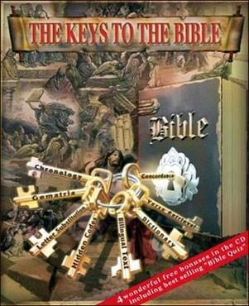
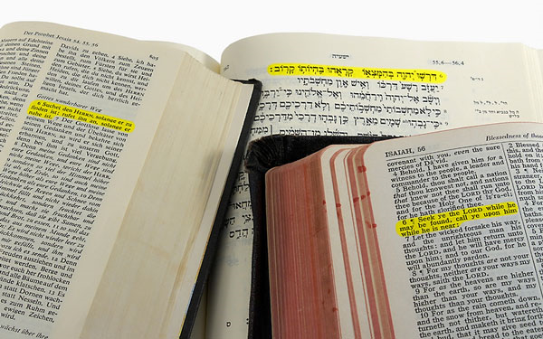
Teaching and Learning the Bible With Adults: Devotional Reading
Diane Jacobson
Tuesday, February 22, 2010

Slide 2
Notes:
2
Jacobson focuses on four ways to approach the Bible in study. These approaches are not the only ways to study the Bible, but they encompass key categories of study that, when used together, help us experience the Bible in a multi-dimensional way. Three of the four approaches we share with other Christians, while the fourth approach (Lutheran Theological Reading) is the unique and helpful “spin” we bring to reading and interpreting Scripture.
These four approaches are used in each of the four Bible studies in the final section of the book, and they will be used as an integrated approach to Bible study in other Book of Faith Bible studies yet to come.

Slide 3
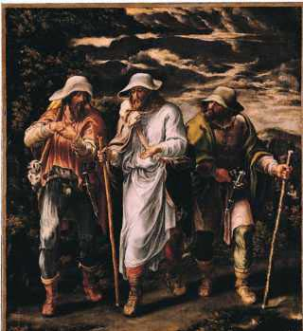
Devotional Reading
Lectio Divina
Basic info from the Benedictines on lectio divina: http://www.osb.org/lectio/index.html
A good general lecture: http://www.osb.org/lectio/olivera.html
An online example: http://sacredspace.ie/
A helpful video about lectio divina: http://www1.csbsju.edu/sot/
seeingtheword/LectioVideo.htm

Slide 4
Devotional Reading
T.R.I.P. http://www.dailytext.com/dailytexts/TRIP.php
Martin Luther’s prayer pattern has been used at Mount Carmel in the form of an acronym which spells T.R.I.P. to outline the discipline of reading a Bible verse, and then asking the following four questions of that verse:
What in that verse am I Thankful for?
What does it reveal that I Regret or need to confess?
How should I Intercede or what should I pray for?
What Purpose for my day does this verse give me?
Thanks, Regret, Intercession, and Purpose, or T.R.I.P.

Slide 5
Devotional Reading
Swedish Marking Method
http://www.matthiasmedia.com.au/briefing/library/5445/
(one candle): This is new for me—a new
understanding, new insight, new appreciation.
ii (two candles): I want to remember/
memorize this verse/idea.
(arrow): This strikes me as
being especially important.
? (question mark): This is not
clear. I need help in
understanding what it says.

Slide 6
Devotional Reading
Kaleidoscope Bible Study Process: Mutual Invitation
(No-Prep Bible Study Method)
http://216.104.171.229/ki/bible-study_process.html
See handout.

Slide 7
Devotional Reading
Various Catechumenate Bible Study Methods
http://www.sclutheran.org/Committees/Bible%20Study%20Methods.doc
See handout.

Slide 8
Devotional Reading
Others??

Slide 9
Devotional Reading
What word or phrase strikes you?
What images come to mind?
What memories does this passage
stir in you?
What delights you?
What confuses
or challenges you?
What is God calling us to be, do, tell?

Slide 10
Devotional Reading
Develop a habit
Listen slowly & carefully.
Attend to the text.
Don’t need expert in the room. Experts can get in the way.
No right answers.
Worst Question:
What do you think?

Slide 11
Notes:
11
No matter what approaches we use when we read and study the Bible, we bring some overarching and guide values. Echoing thoughts from chapter 1 and from Martin Luther’s own approach, Diane Jacobson lists some of these values:
We come prayerfully asking that the Holy Spirit might guide our study and that Christ might be among us.
We come to the Bible humbly, asking for the gift of faith and ever mindful of our own capacity for sin and self-deceit.
We come mindfully, bringing to our study the gifts of reason, the tools of scholarship, and the insights of others.
We come attentively, reading Scripture carefully and closely.
We come in the context of a faithful community, letting our stories interact with the stories of the Bible.
And we come expectantly, listening for the voice of God working through the text and in the mutual study to inspire, shape, and enliven us individually and as a community of faith.

